Slide 1
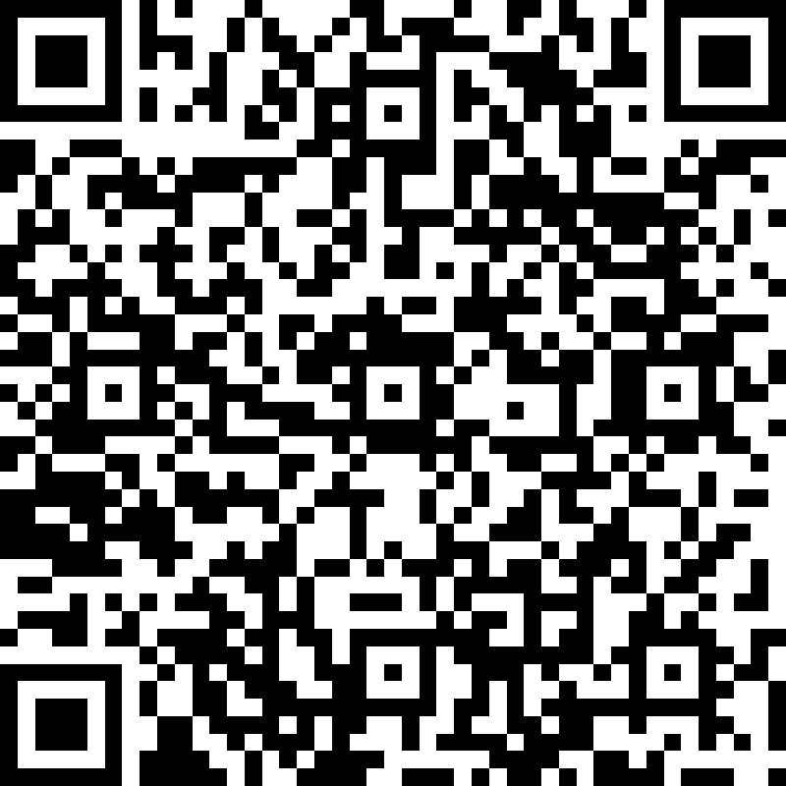
Better Computer Skills in 10 Weeks
Getting Started with Computers
Basic keyboarding and mouse skills
Password management
Navigating Windows
Introduction to email
Tuesdays & Thursdays
3:30-5:00pm
January 17th to March 30th
Charles River Plaza, 165 Cambridge St.
Beyond the Basics: Intermediate Computer Skills
Typing efficiently; keyboard shortcuts
Creating and saving documents
Email formatting, attachments, and calendars
Overview of MGH web-based applications
Tuesdays & Thursdays
1:30-3:00pm
January 17th to March 30th
Charles River Plaza, 165 Cambridge St.
To register, contact Stephanie LaShoto-Westfield
774-219-5147 (call or text): slashoto@partners.org
Classes are available to MGH employees, and sponsored by Mass General Brigham Workforce Development

