Slide 1
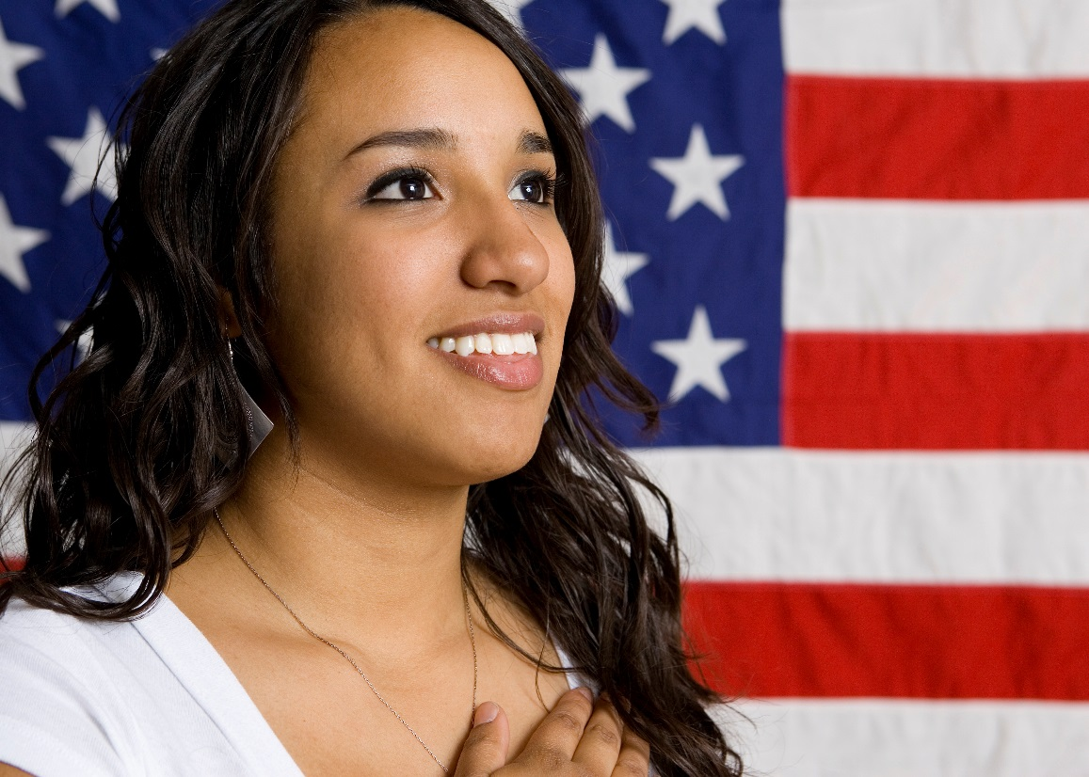
US Citizenship Interview Preparation Course
Available to Mass General Brigham employees and family members!
Prepare for Citizenship interview and civics test
Additional application submission support from Project Citizenship
Upcoming Class Schedule:
Thursdays, October 6th to October 27th
Or
Mondays, November 7th to 28th
5:30-7:30pm via Zoom
Self study option available
In order to enroll, you must:
be a permanent resident
(Green Card holder)
be moderately proficient in English
Visit Ask My HR, or email, call or text:
jvscitizenship@jvs-boston.org 617-399-3224
These classes are sponsored by Mass General Hospital and are offered at no cost.

